Slide 1

ERP Implementation for XMPS
Optimizing workflows with our comprehensive ERP solution.

Slide 2
Deploying an Integrated Odoo ERP Solution for XMPS Businesses
1. Shawqy Naif Mohamed Shawqy Mahmoud. 2. Mario Bahaa William Abskhiron. 3. Nada Salah Eltantawy shady. 4. Bassem Fawzy Kamel. 5. Ahmed Elsaied Diab Abdelbary Mohamed.

Slide 3
Business Context:
XMPS specializes in providing managed printing services to hospitals and medical centers. XMPS owns and installs printing machines at client locations, ensuring continuous operation by handling maintenance, supplying ink, and replacing spare parts.
Installation & Ownership:
Maintenance & Support:
Consumables Supply:
Revenue Model:
XMPS provides ink and other necessary supplies for the machines.
XMPS generates revenue from selling paper used in the printing process.
XMPS installs its own printing machines at hospitals and medical centers.
XMPS is responsible for maintenance, repairs, and spare parts replacement to ensure smooth operation.
Clients purchase printing paper and medical films from XMPS to use with the machines.
Clients do not own the machines; they use them under a service agreement.
Technical support is provided as part of the service.

Slide 4
Problem Statement:
XMPS currently uses QuickBooks & Excel for accounting and warehouse management. However, the company faces challenges in accurately determining expenses for each client due to limitations in tracking costs associated with machine maintenance, consumables, and spare parts usage per client. This lack of precise expense allocation affects financial reporting, cost control, and profitability analysis. To address these challenges, Odoo will be implemented to provide a more integrated and detailed expense tracking system, ensuring better cost visibility, improved financial management, and enhanced decision-making.

Slide 5
Purchase Module:
Vendors
Products
Purchase Agreements
Units of Measure

Slide 6
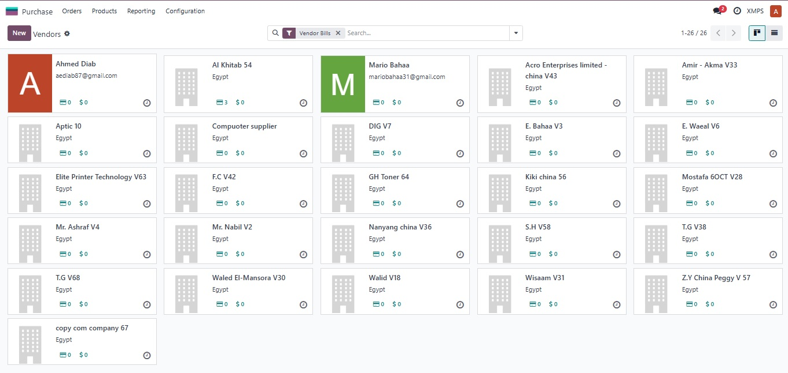

Slide 7
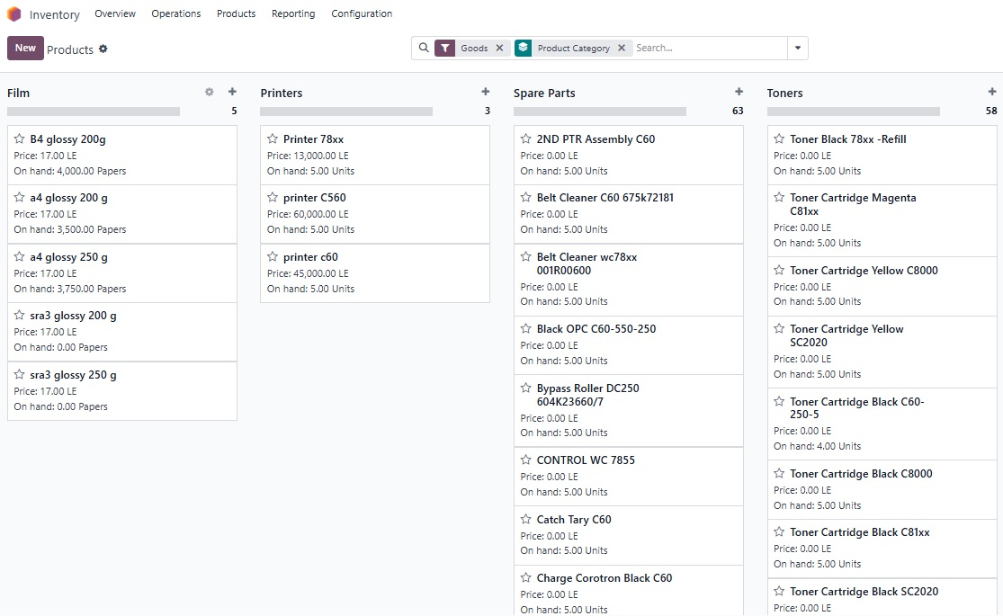

Slide 8
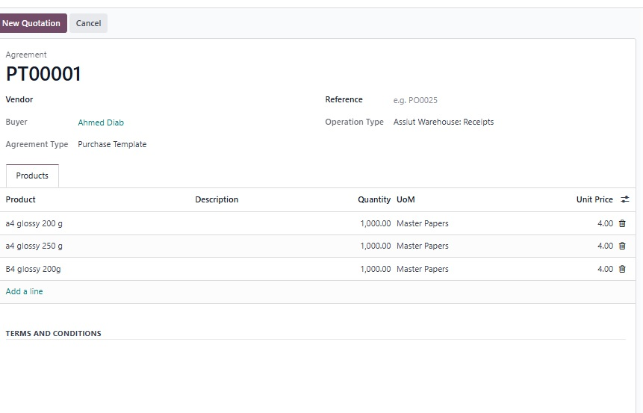
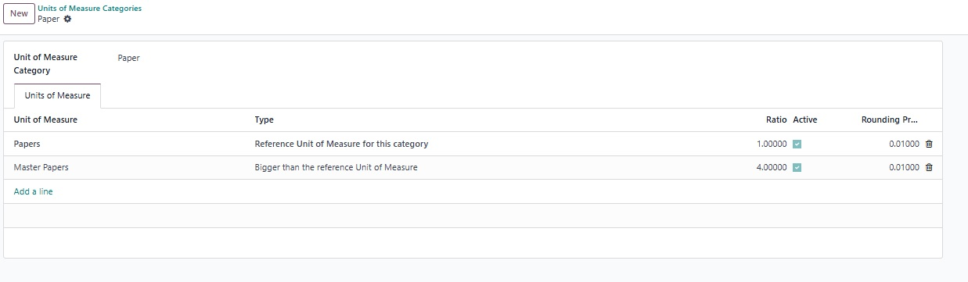
Purchase Template
Unit of Measure

Slide 9

Inventory Module: Warehouse Management
Cairo & Assiut & Hospital
Warehouse
Film, printers, spare parts, toners & Hospital
Manage warehouse locations.
Putaway Rules
Efficient stock placement.

Slide 10
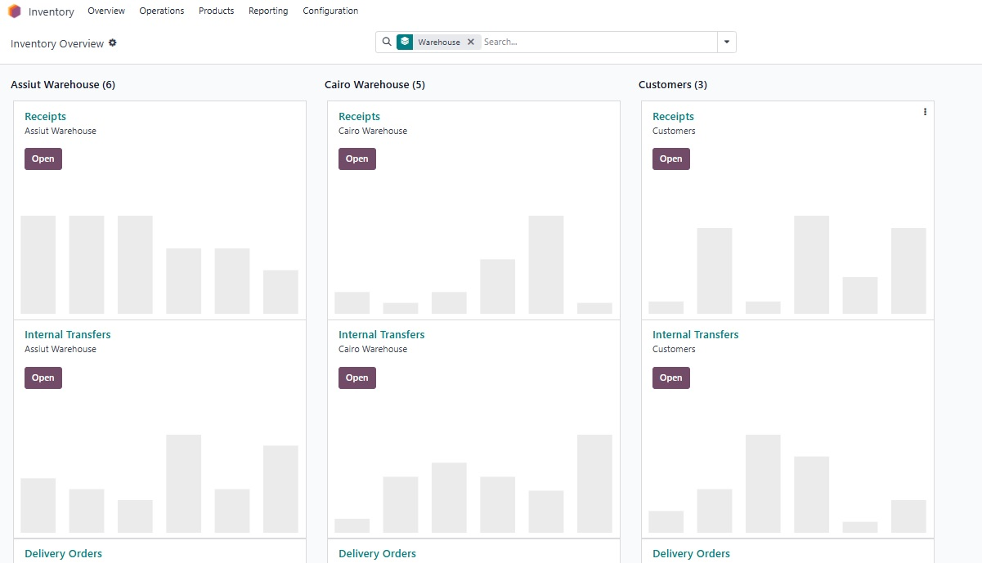
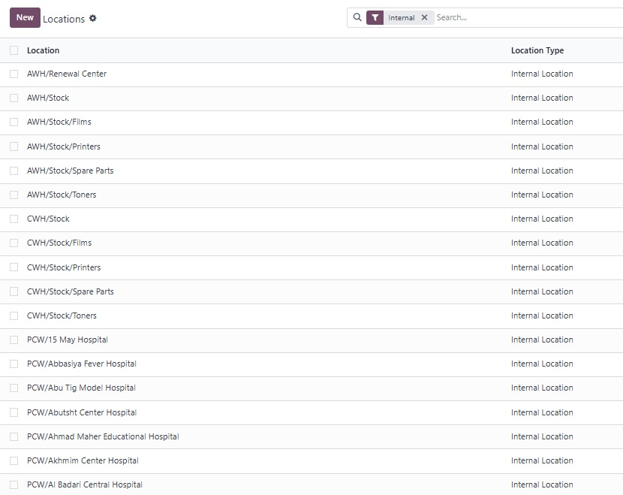
Warehouses
Internal Locations

Slide 11
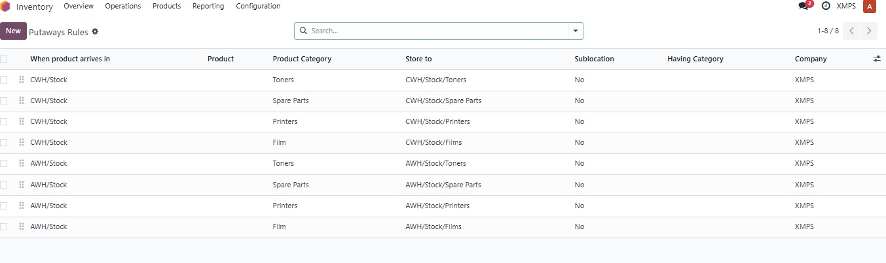
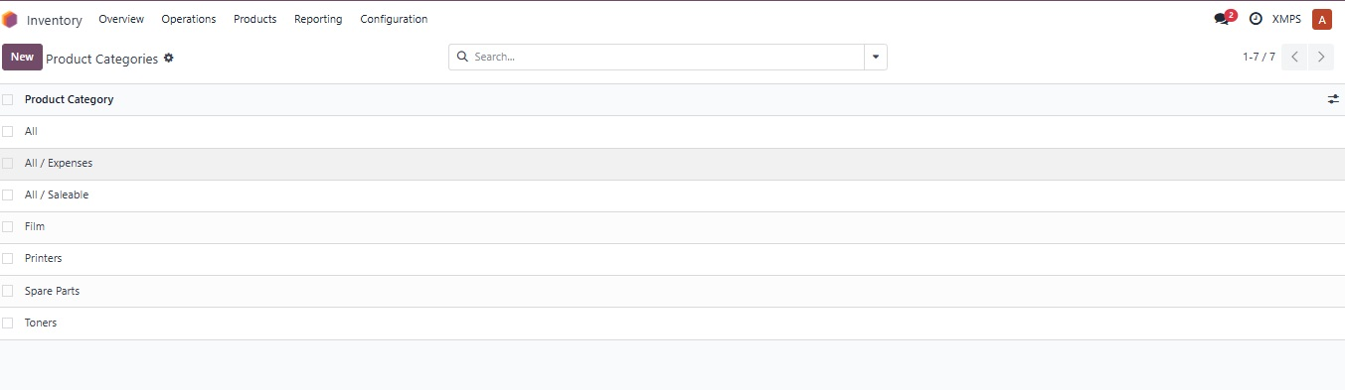

Slide 12
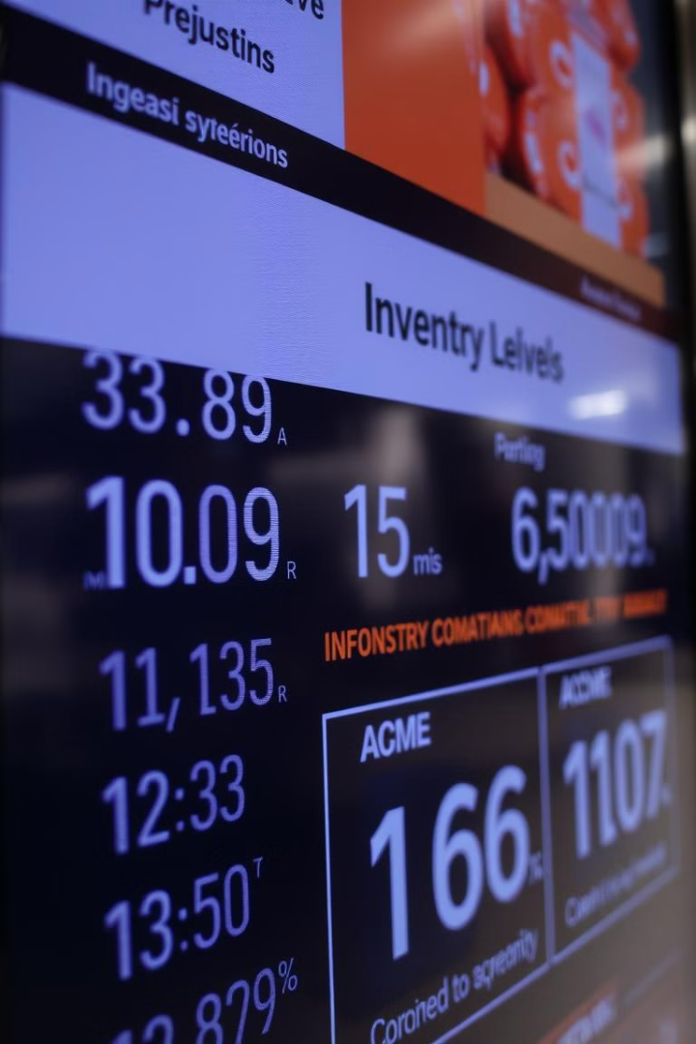





Inventory: Virtual Locations & Product Categories
Maintenance Account
Spare parts & toner tracking.
Printer Renewal
Renewal of depreciated assets.
Categories
Film, Printers, Spares, Toner.
Tracking serial number
For printers
Product Packagings

Slide 13
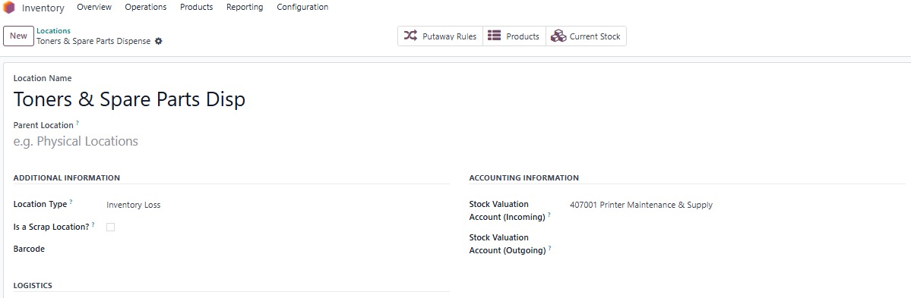
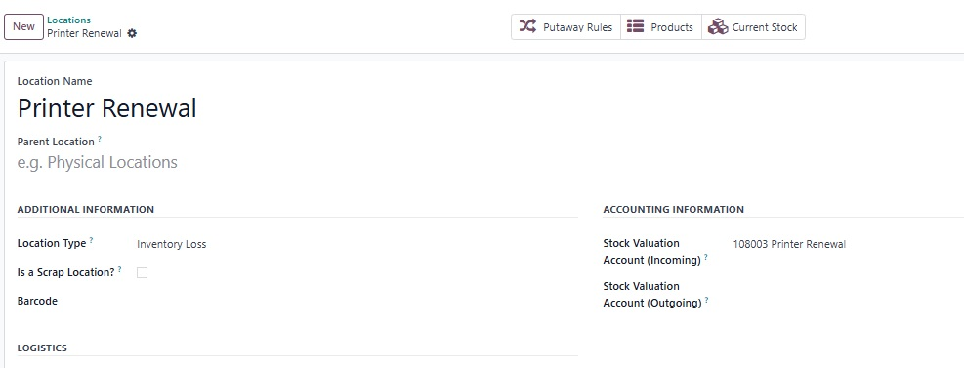

Slide 14
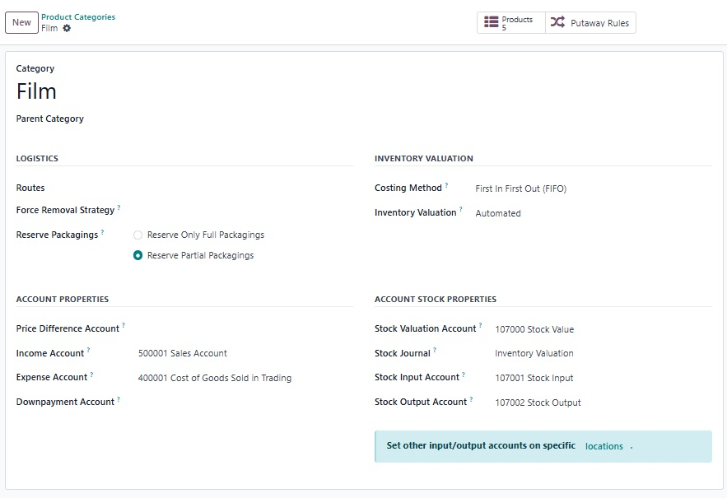
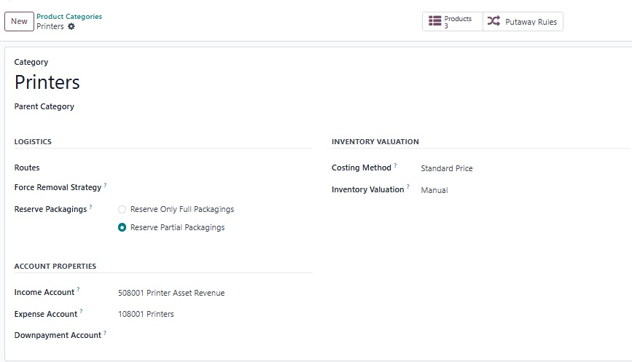

Slide 15
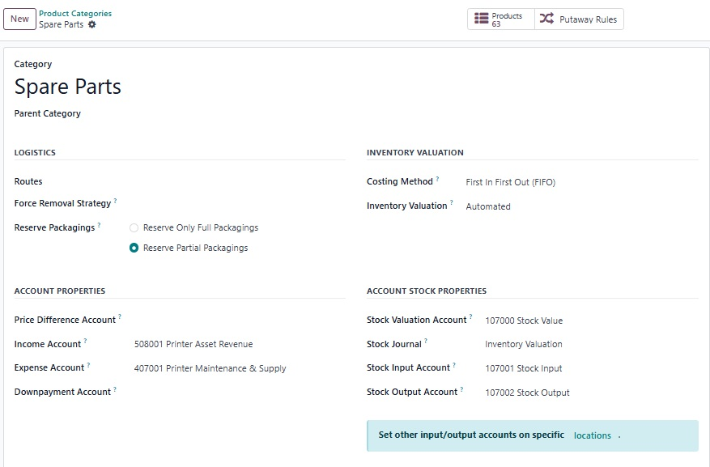
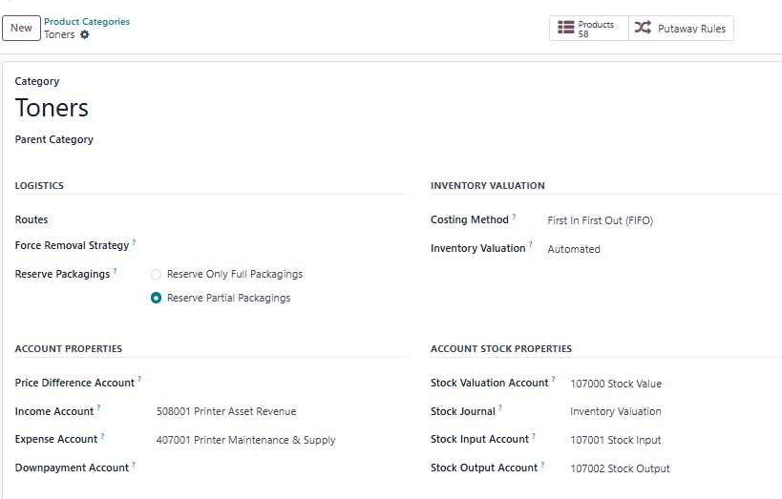

Slide 16
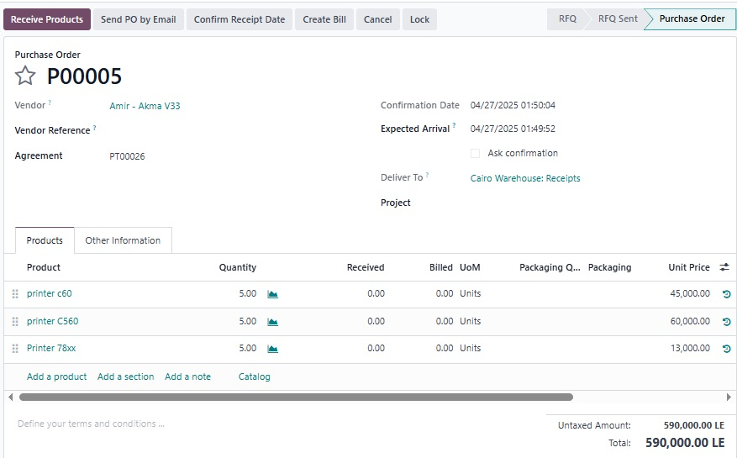

Slide 17
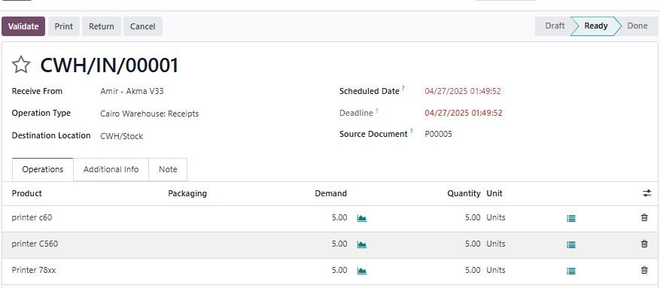
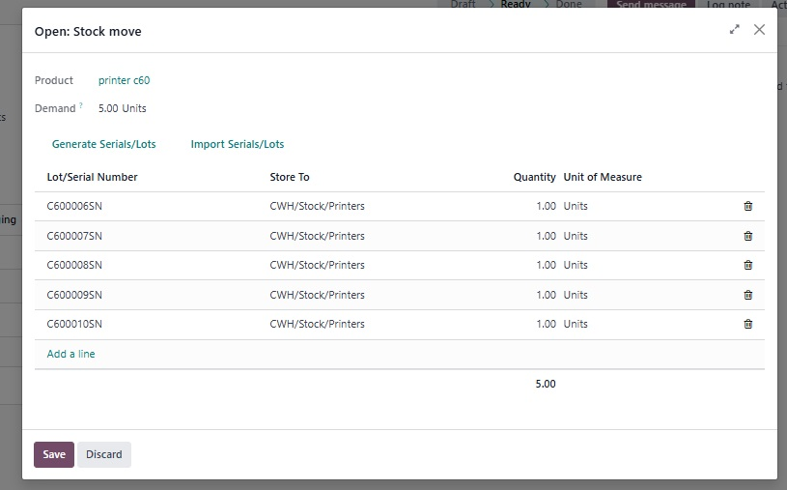

Slide 18
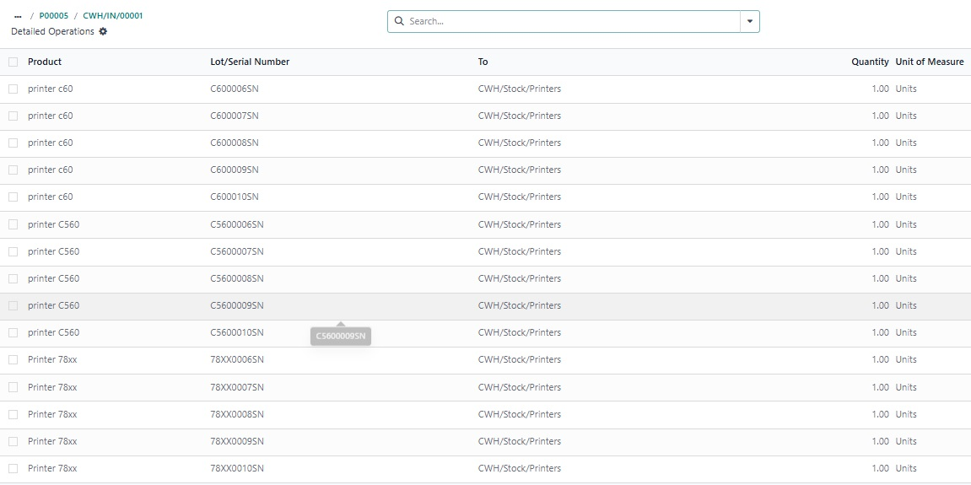

Slide 19
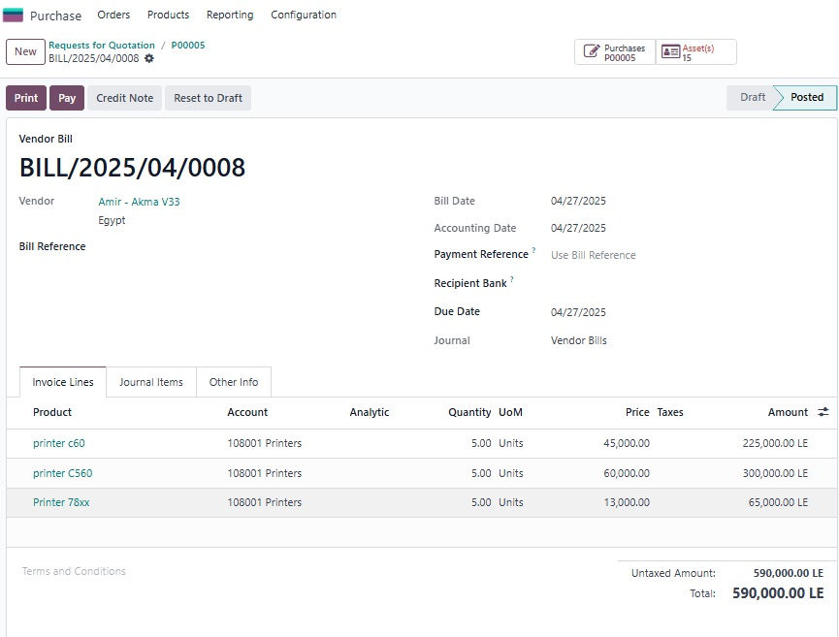

Slide 20
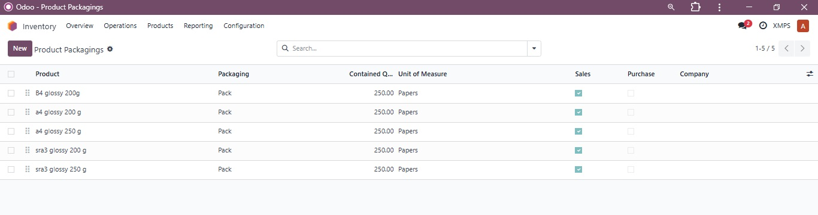

Slide 21




Expenses & Employee Management
Expense Category
Employee Creation
Technician Visits.
Technician profiles.
Project Assignment
Task tracking.

Slide 22
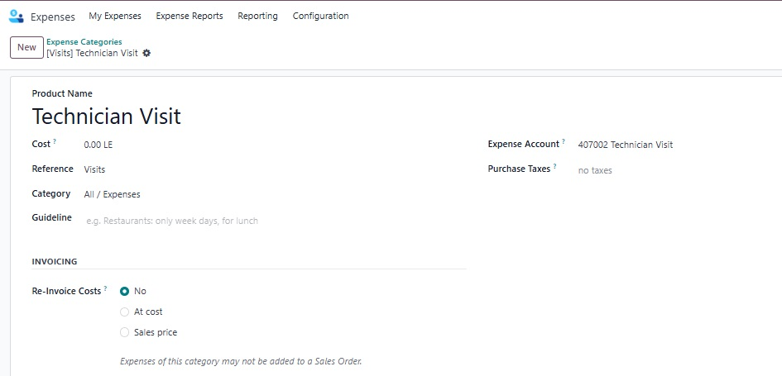
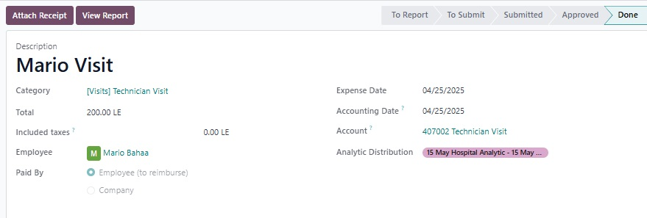

Slide 23







Accounting:
· Anglo Saxon
· Chart of Accounts
1
2
· Enable Automatic Accounting
· Asset reevaluation
7
3
6
4
Cash Journals for Assiut, Cairo and Miscellenous Journal for Printers.
· Analytic Accounts
5
· Asset Model

Slide 24
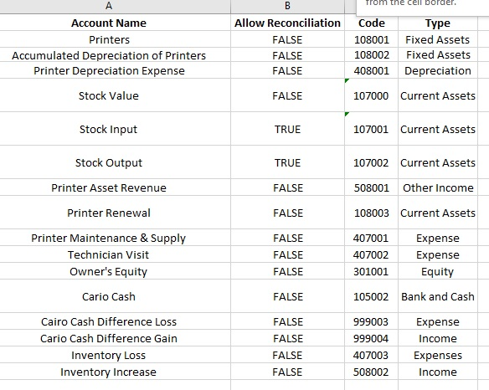
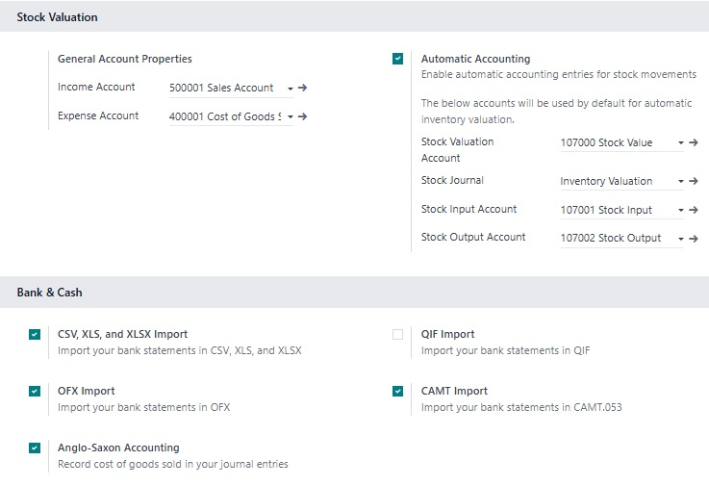

Slide 25
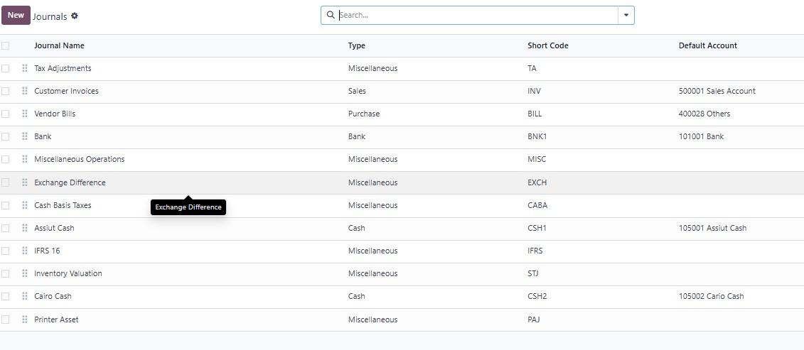

Slide 26
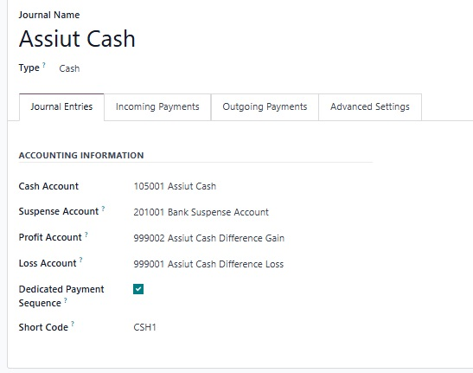
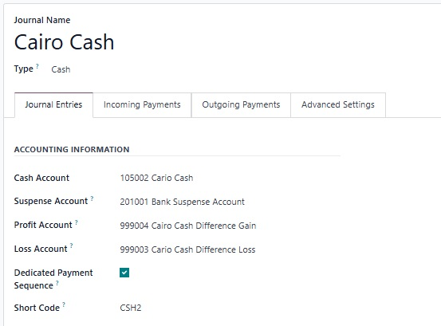
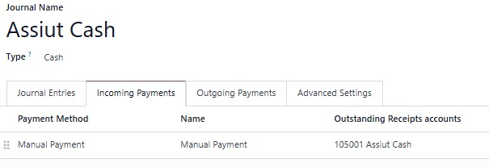
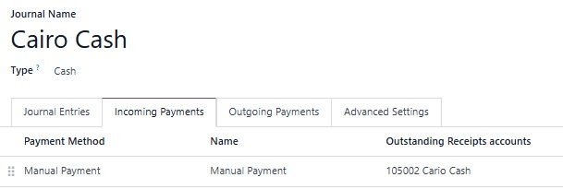
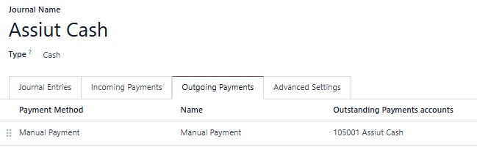
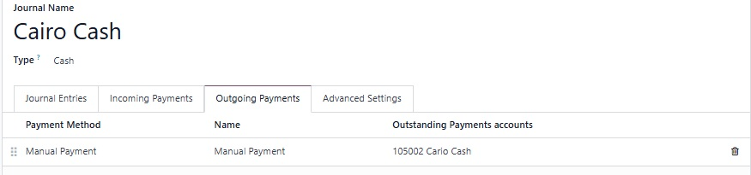

Slide 27
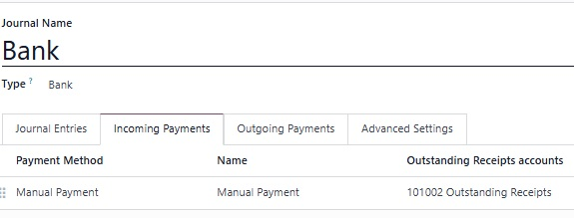
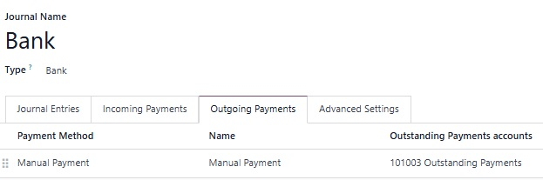
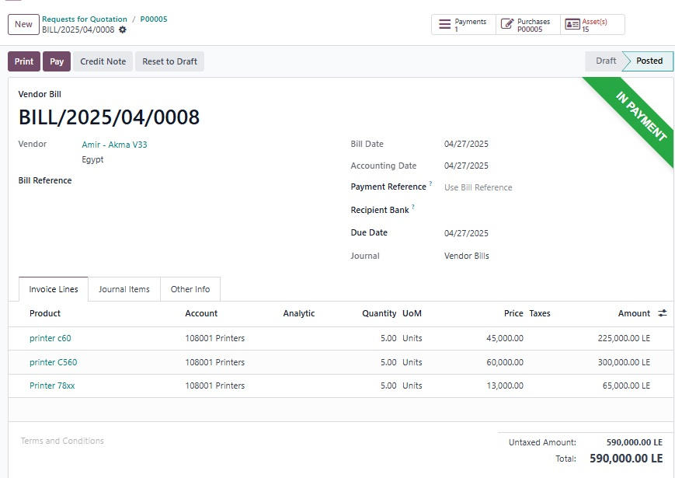
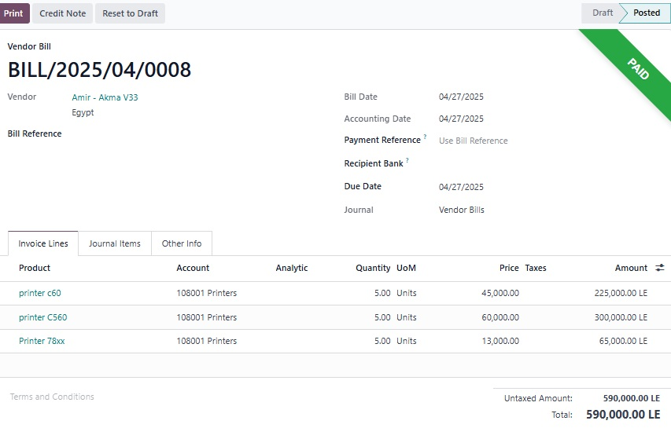

Slide 28
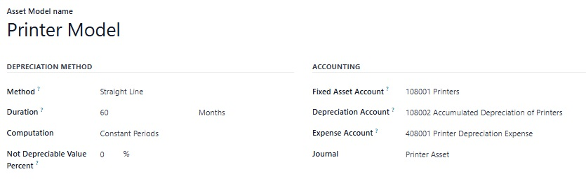
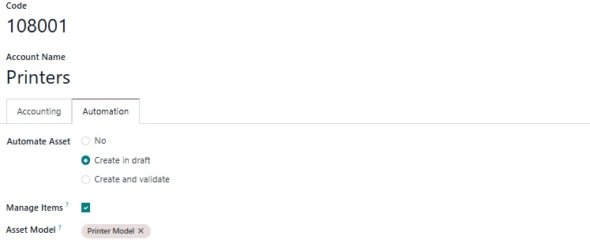

Slide 29
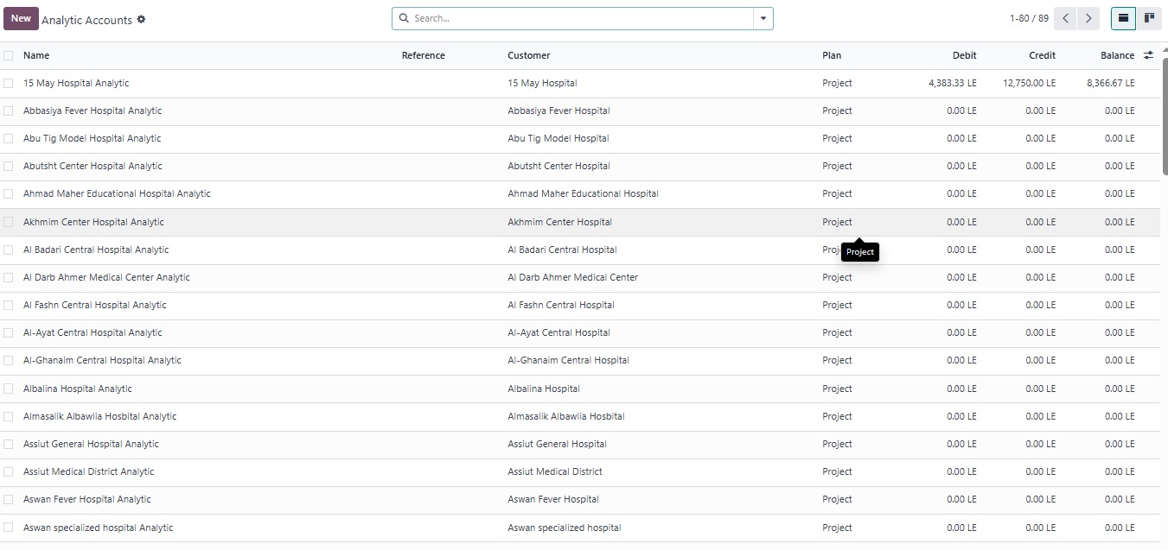

Slide 30
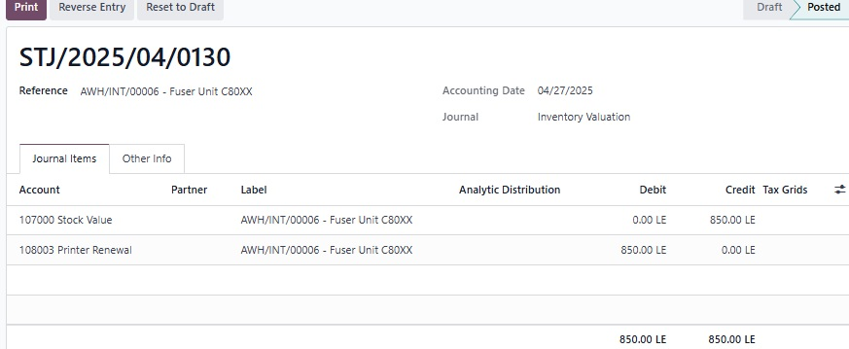
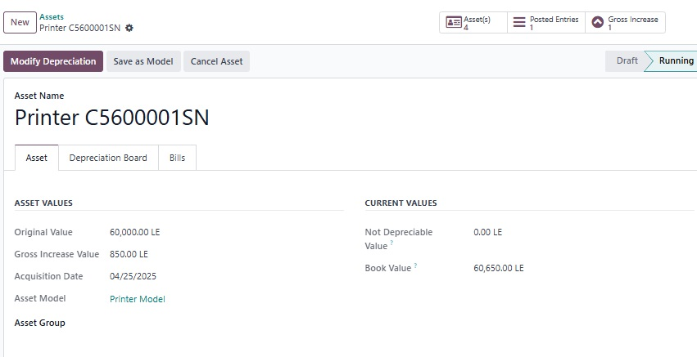

Slide 31


Sales Module: Customer & Price Management
Customers
Price Lists
Client database.
Multiple pricing tiers.

Slide 32
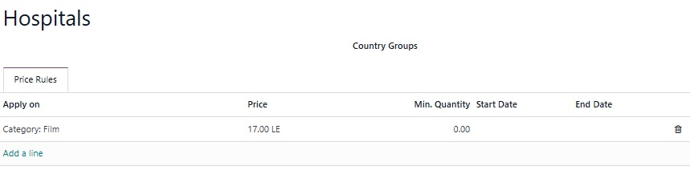
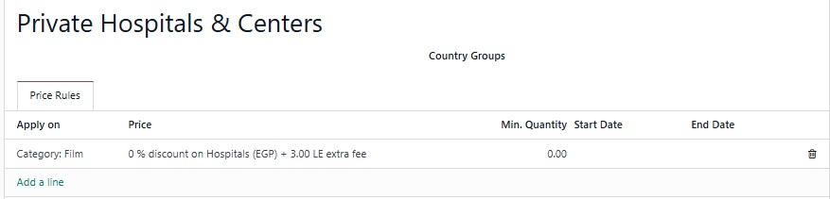

Slide 33
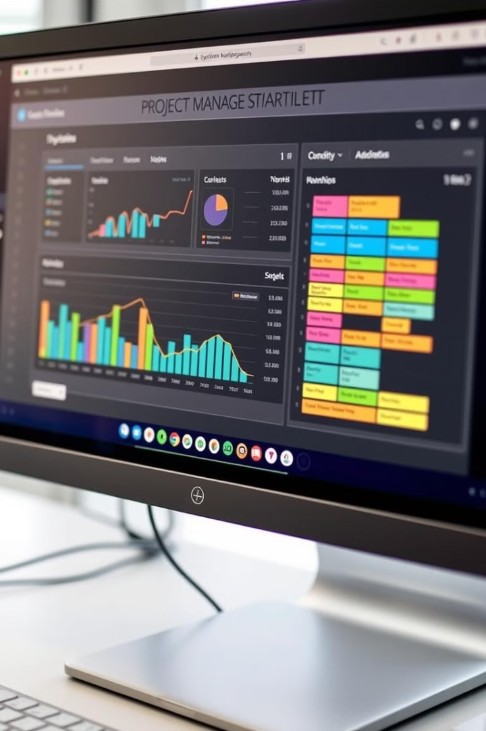


Project Management: Task Stages & Analytics
Task Stages
Workflow progress.
Analytic Accounts
Customer linked to project.
Top Bar
Key Performance Indicators.

Slide 34
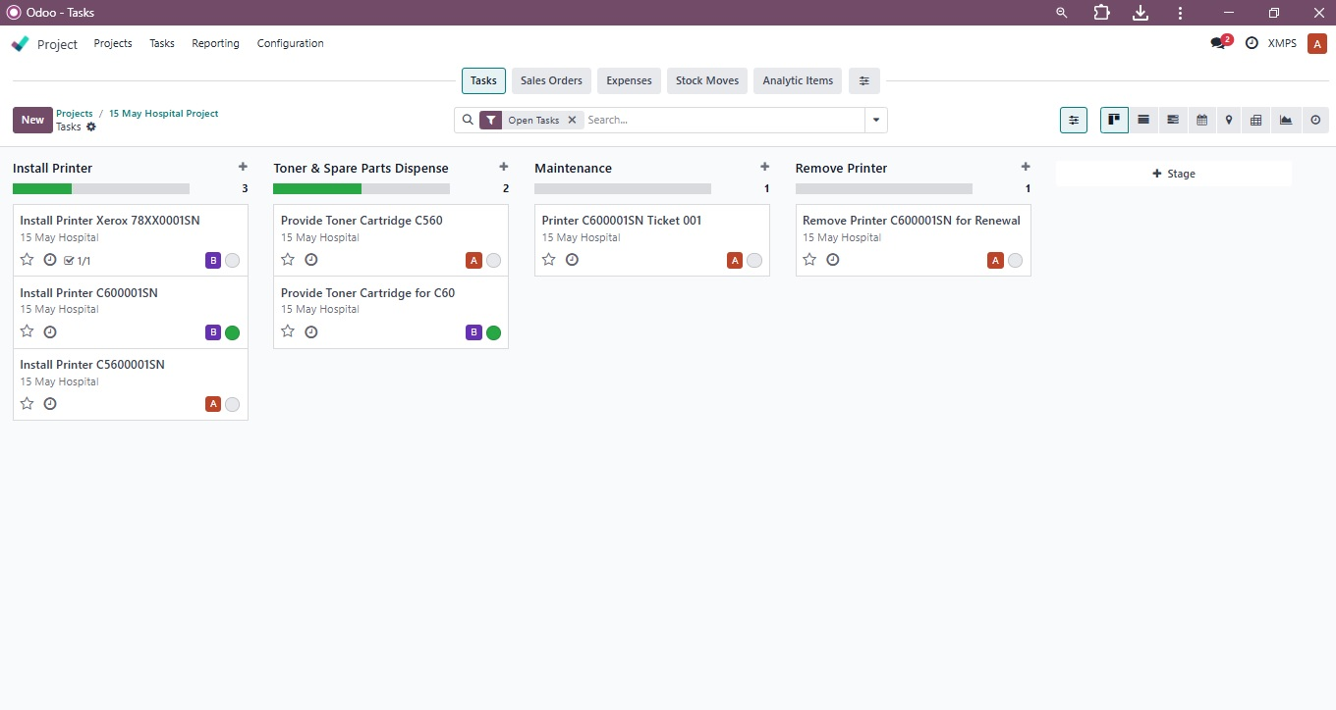
Task Stages

Slide 35
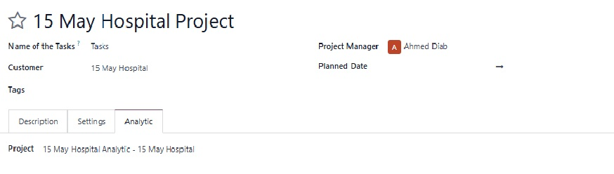
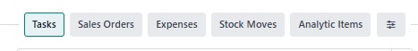
Analytic Account For Specific Project
Topbar

Slide 36
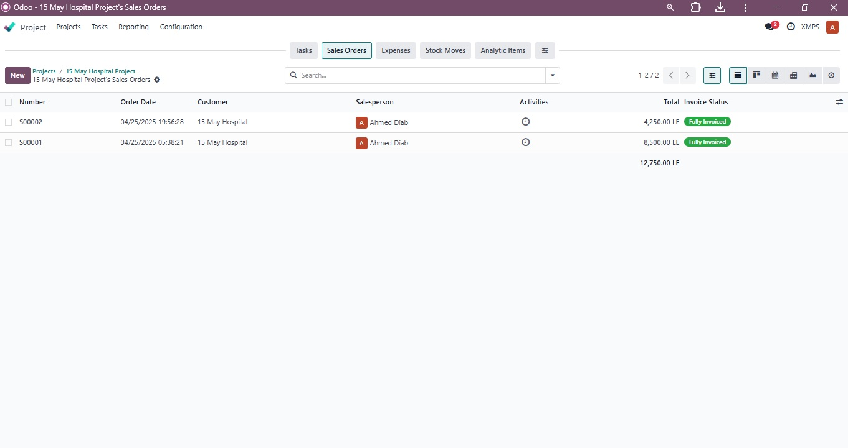

Slide 37
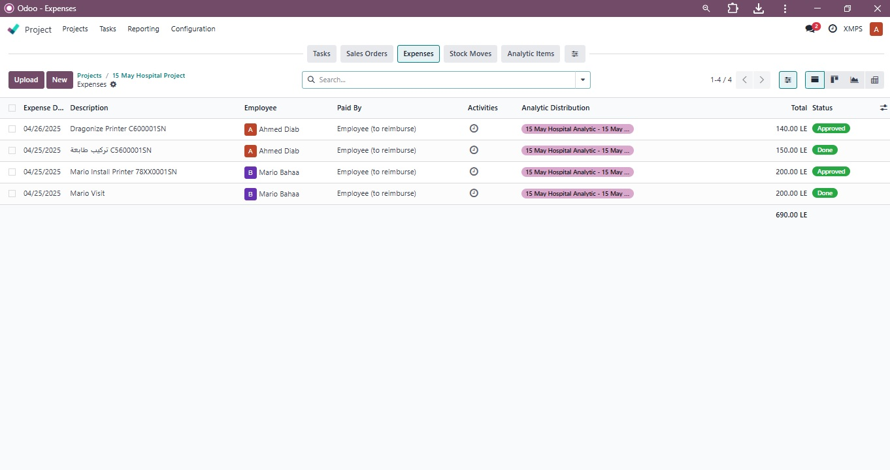

Slide 38
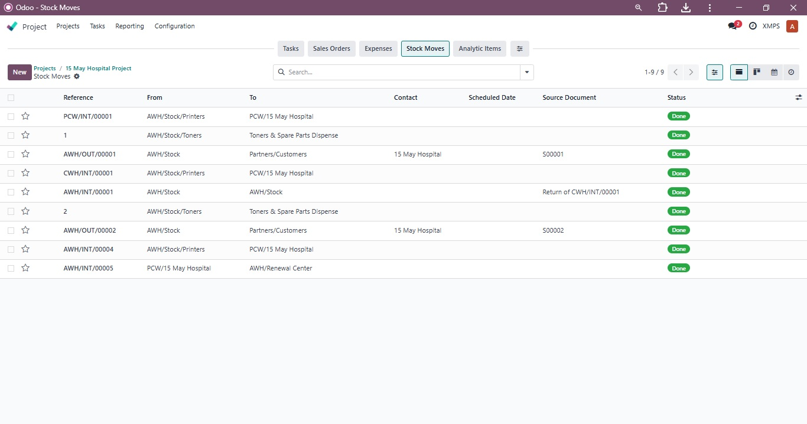

Slide 39


